Slide 1
Notes:
‹#›

Slide 2
A Chemical Connection to Biology
Biology is the study of life
Organisms and their environments are subject to basic laws of physics and chemistry
One example is the use of formic acid by ants to protect themselves against predators and microbial parasites

Slide 3
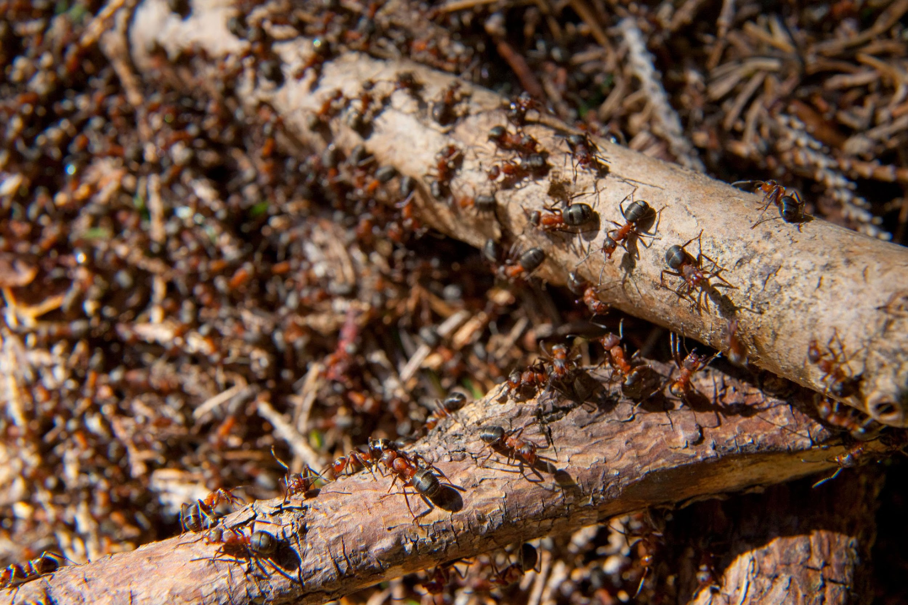
Figure 2.1
What weapon do these wood ants use to deter predators?
Notes:
Figure 2.1 What weapon do these wood ants use to deter predators?

Slide 4
Concept 2.1: Matter consists of chemical elements in pure form and in combinations called compounds
Organisms are composed of matter
Matter is anything that takes up space and has mass

Slide 5
Elements and Compounds
Matter is made up of elements
An element (元素) is a substance that cannot be broken down to other substances by chemical reactions
A compound (化合物) is a substance consisting of two or more elements in a fixed ratio
A compound has characteristics different from those of its elements

Slide 6
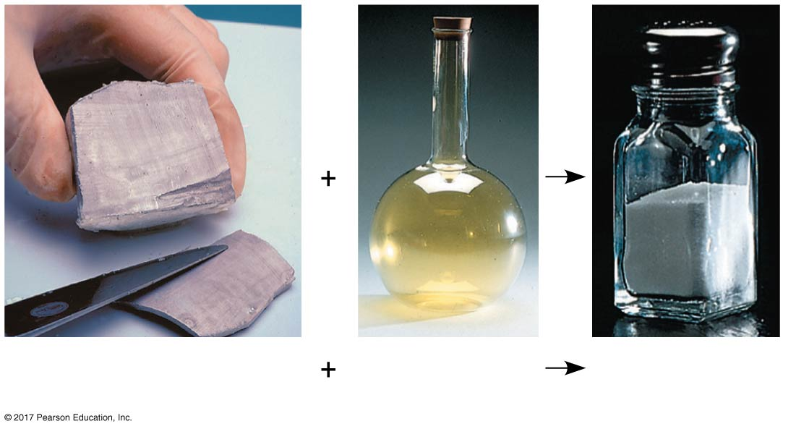
Figure 2.2
The emergent properties of a compound
Na
Cl
NaCl
Sodium
Chlorine
Sodium chloride
Notes:
Figure 2.2 The emergent properties of a compound

Slide 7
The Elements of Life
About 20–25% of the 92 natural elements are required for life (essential elements)
Carbon, hydrogen, oxygen, and nitrogen make up 96% of living matter
Most of the remaining 4% consists of calcium, phosphorus, potassium, and sulfur
Trace elements(微量元素)are required by an organism in only minute quantities

Slide 8
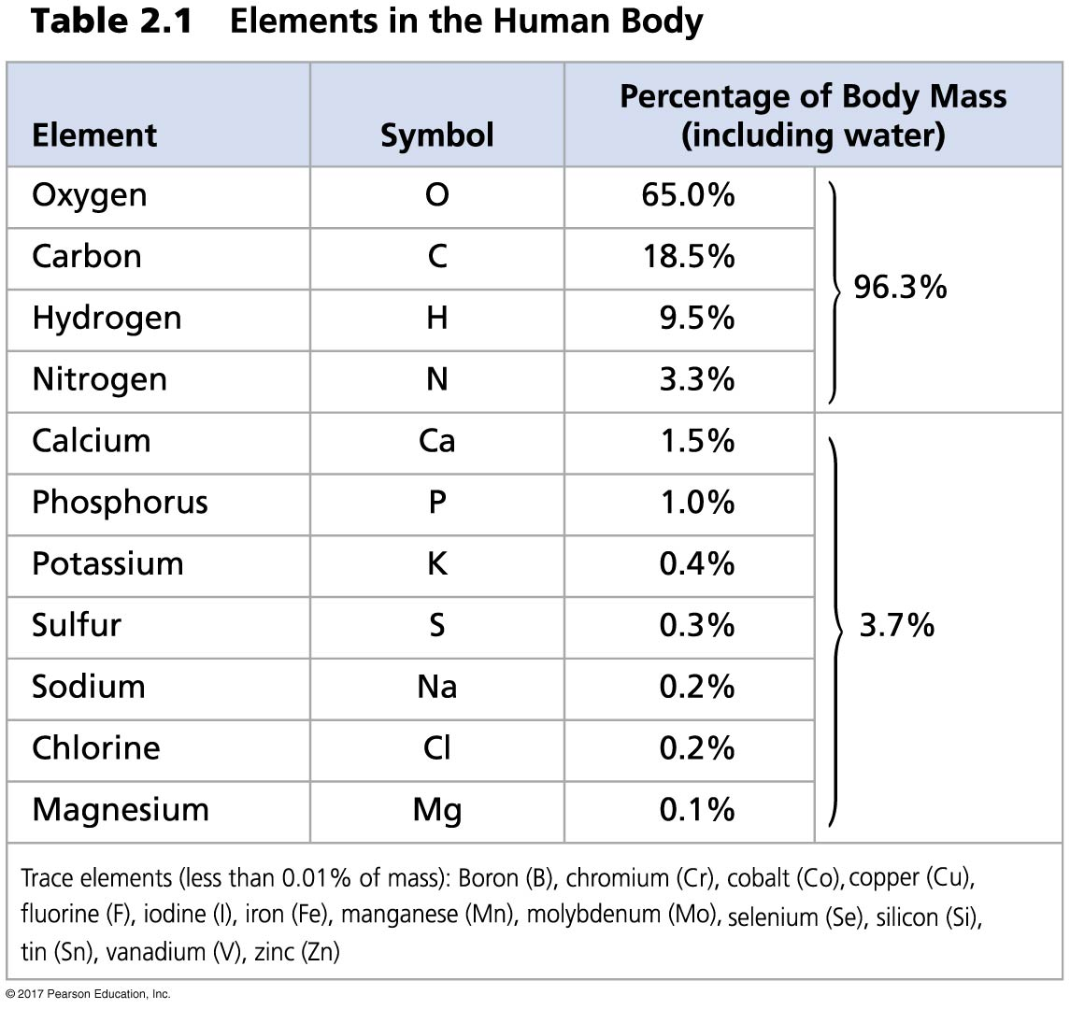
Table 2.1
Notes:
Table 2.1 Elements in the human body

Slide 9
Case Study: Evolution of Tolerance to Toxic Elements
Some elements can be toxic
Some species can become adapted to environments containing toxic elements
For example, some plant communities are adapted to serpentine

Slide 10
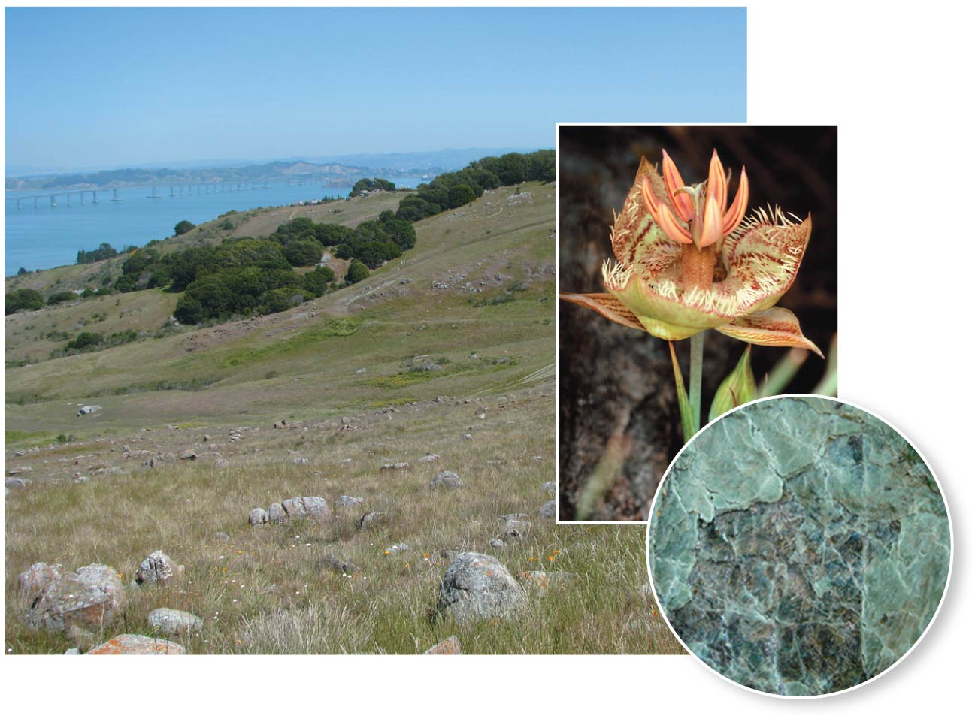
Figure 2.3
Serpentine plant community
Notes:
Figure 2.3 Serpentine plant community

Slide 11
Concept 2.2: An element’s properties depend on the structure of its atoms
Each element consists of unique atoms
An atom is the smallest unit of matter that still retains the properties of an element

Slide 12
Subatomic Particles
Atoms are composed of subatomic particles
Relevant subatomic particles include
Neutrons (no electrical charge)
Protons (positive charge)
Electrons (negative charge)

Slide 13
Neutrons and protons form the atomic nucleus (原子核)
Electrons form a “cloud” of negative charge around the nucleus
Neutron mass and proton mass are almost identical and are measured in daltons

Slide 14
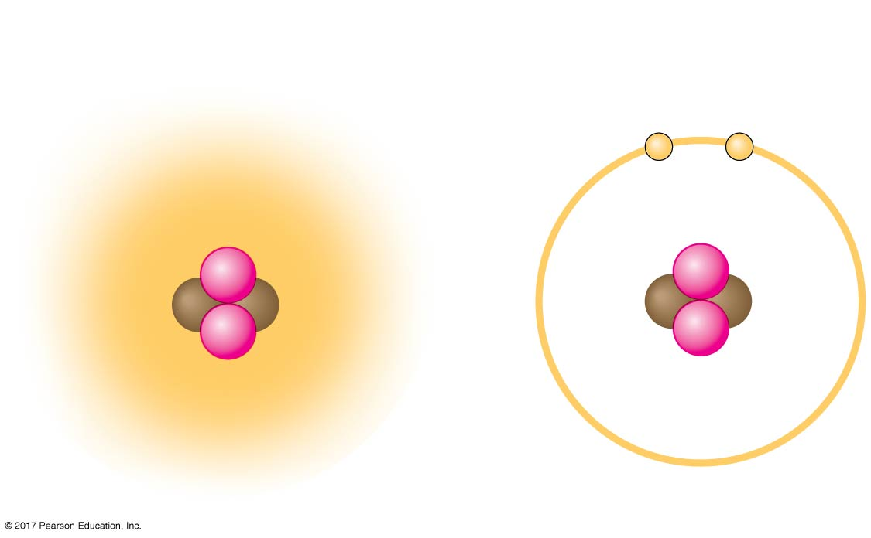
Figure 2.4
Simplified models of a helium (He) atom
Cloud of negative
charge (2 electrons)
Electrons
Nucleus
−
−
+
+
+
+
(a)
(b)
Notes:
Figure 2.4 Simplified models of a helium (He) atom

Slide 15
Atomic Number and Atomic Mass
Atoms of the various elements differ in number of subatomic particles
An element’s atomic number is the number of protons in its nucleus
An element’s mass number is the sum of protons plus neutrons in the nucleus
Atomic mass, the atom’s total mass, can be approximated by the mass number

Slide 16
Isotopes
All atoms of an element have the same number of protons but may differ in number of neutrons
Isotopes are two atoms of an element that differ in number of neutrons
Radioactive isotopes decay spontaneously, giving off particles and energy

Slide 17
Radioactive Tracers
Radioactive isotopes are often used as diagnostic tools in medicine
Radioactive tracers can be used to track atoms through metabolism
They can also be used in combination with sophisticated imaging instruments

Slide 18
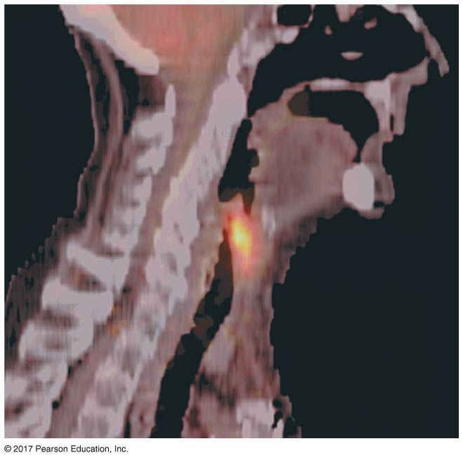
Figure 2.5
A PET scan, a medical use for radioactive isotopes
Cancerous
throat
tissue
Notes:
Figure 2.5 A PET scan, a medical use for radioactive isotopes

Slide 19
Radiometric Dating
A “parent” isotope decays into its “daughter” isotope at a fixed rate, expressed as the half-life
In radiometric dating, scientists measure the ratio of different isotopes and calculate how many half-lives have passed since the fossil or rock was formed
Half-life values vary from seconds or days to billions of years

Slide 20
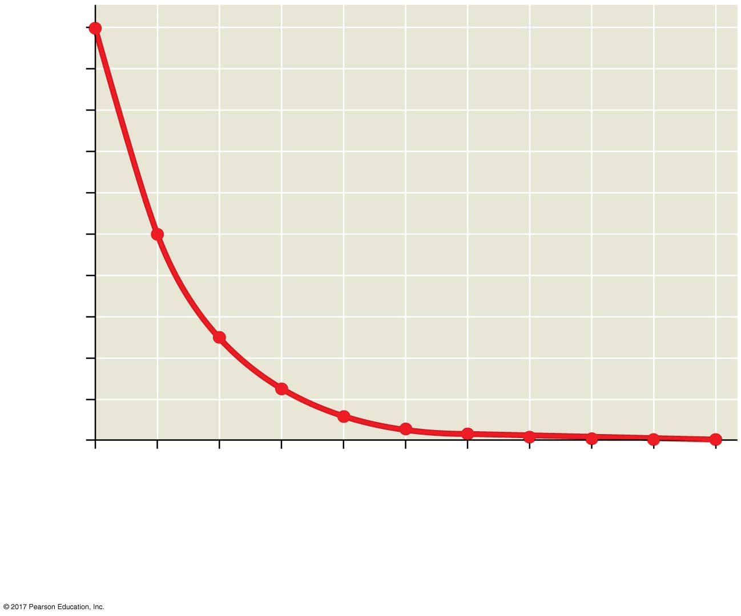
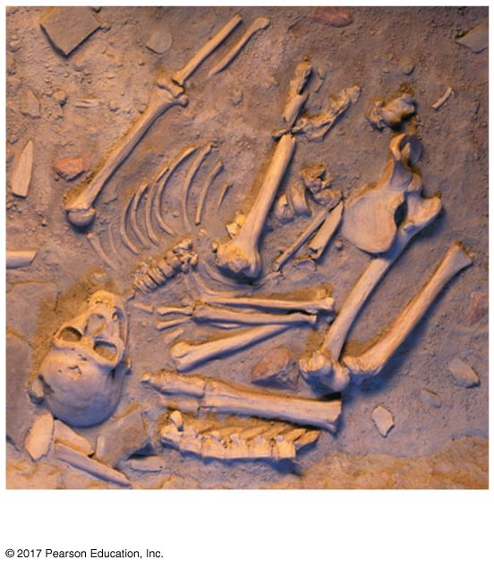
Figure 2.UN01a
1.0
0.9
0.8
0.7
0.6
Fraction of isotope remaining in fossil
0.5
0.4
0.3
Neanderthal fossils
0.2
0.1
0
0
1
2
3
4
5
6
7
8
9
10
Time before present (half-lives)
Data from R. Pinhasi et al., Revised age of late Neanderthal occupation and the end of
the Middle Paleolithic in the northern Caucasus, Proceedings of the National Academy
of Sciences USA 147:8611–8616 (2011). doi 10.1073/pnas.1018938108
Notes:
Figure 2.UN01a Skills exercise: calibrating a standard radioactive isotope decay curve and interpreting data (part 1)

Slide 21
The Energy Levels of Electrons
Energy is the capacity to cause change
Potential energy is the energy that matter has because of its location or structure
The electrons of an atom differ in their amounts of potential energy
An electron’s state of potential energy is called its energy level, or electron shell

Slide 22
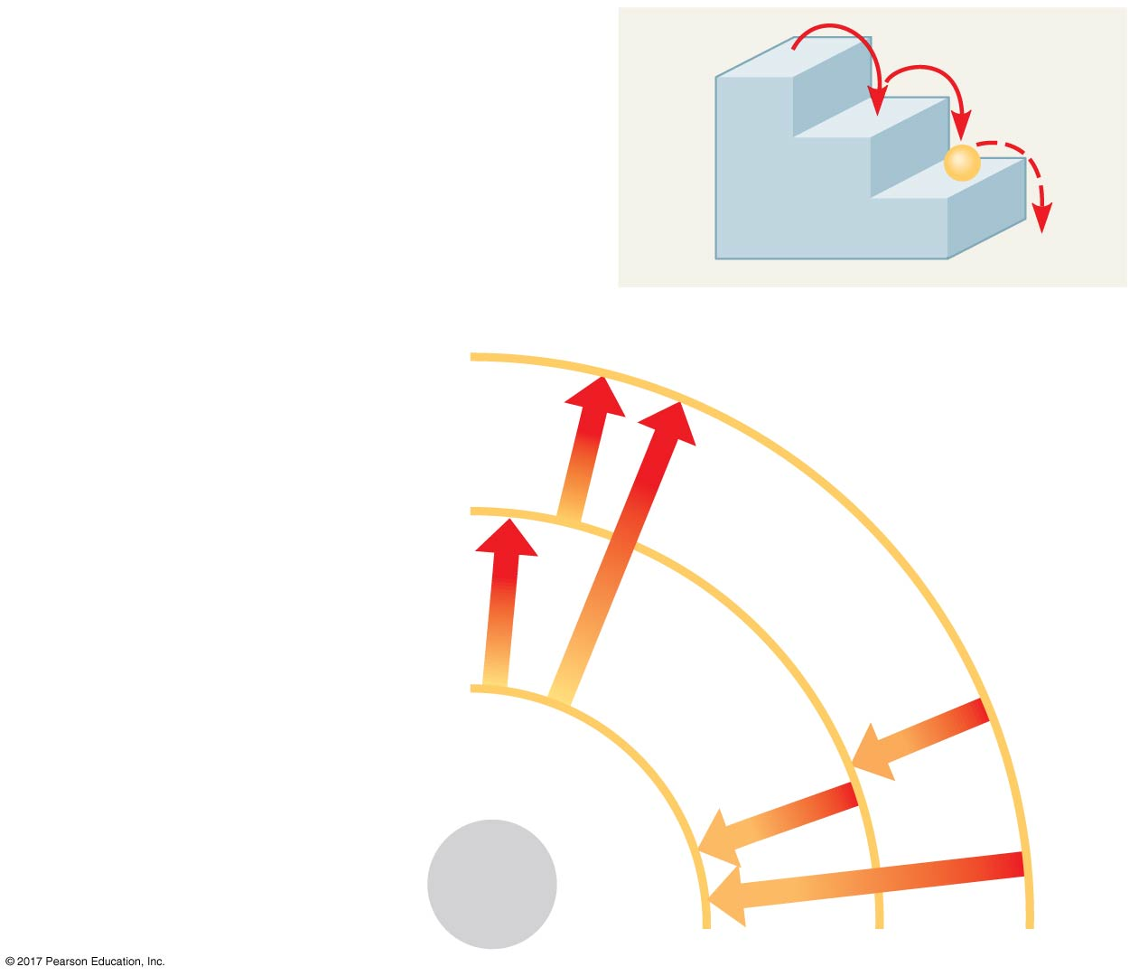
Figure 2.6
A ball bouncing down a flight of stairs can come to rest only on each step, not between steps.
Third shell (highest energy
level in this model)
Second shell (higher
energy level)
Energy
absorbed
First shell (lowest energy
level)
Energy
lost
Atomic
nucleus
(b)
Notes:
Figure 2.6 Energy levels of an atom’s electrons

Slide 23
Electron Distribution and Chemical Properties
The chemical behavior of an atom is determined by the distribution of electrons in electron shells
The periodic table of the elements shows the electron distribution for each element

Slide 24
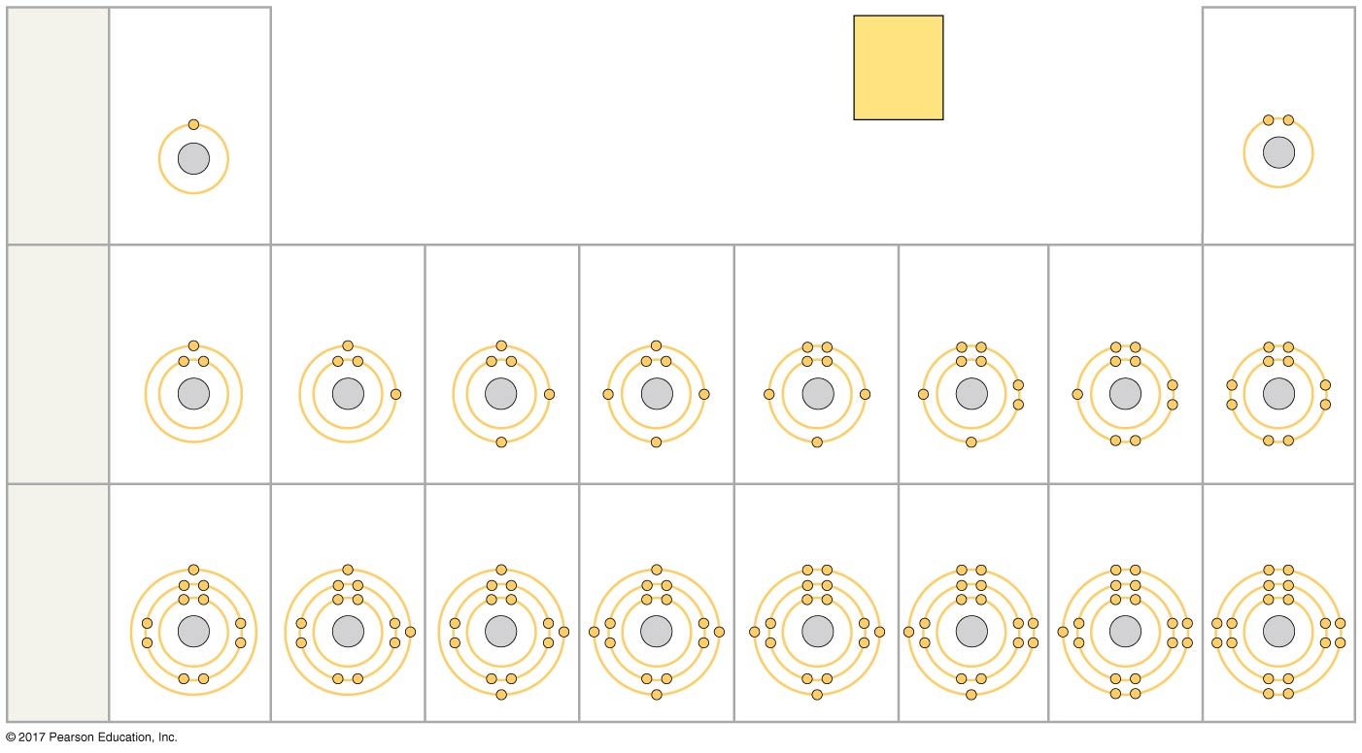
Figure 2.7
Hydrogen
2
Atomic number
Helium
1
H
He
2
He
First
shell
Atomic mass
4.003
Element symbol
Electron
distribution
diagram
Lithium
Beryllium
Boron
Carbon
Nitrogen
Oxygen
Fluorine
Neon
3
Li
4
Be
5
B
6
C
7
N
8
O
9
F
10
Ne
Second
shell
Sodium
Magnesium
Aluminum
Silicon
Phosphorus
Sulfur
Chlorine
Argon
11
Na
12
Mg
13
AI
14
SI
15
P
16
S
17
CI
18
Ar
Third
shell
Notes:
Figure 2.7 Electron distribution diagrams for the first 18 elements in the periodic table

Slide 25
Valence(價)electrons are those in the outermost shell, or valence shell
The chemical behavior of an atom is mostly determined by the valence electrons
Elements with a full valence shell are chemically inert

Slide 26
Electron Orbitals
An orbital is the three-dimensional space where an electron is found 90% of the time
Each electron shell consists of a specific number of orbitals

Slide 27
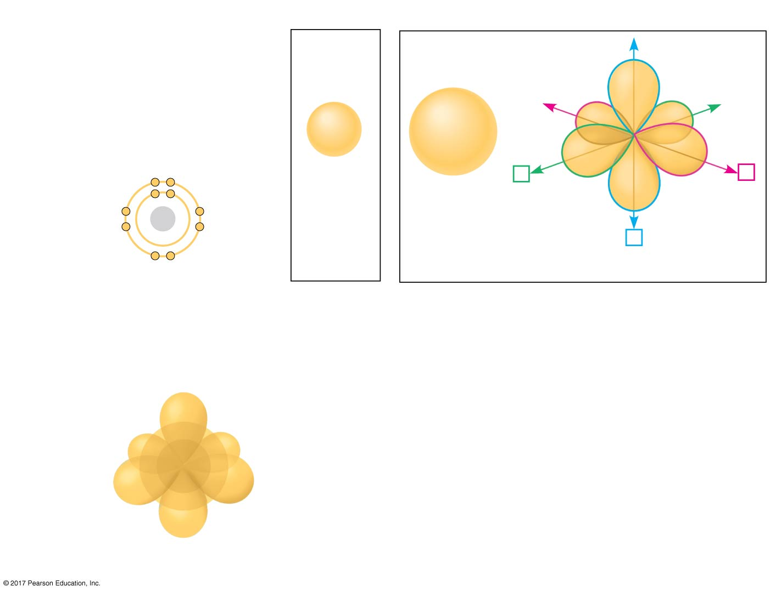
Figure 2.8
Electron orbitals
First shell
Second shell
x
y
Neon,
with two
filled shells
(10 electrons)
First
shell
z
Second
shell
1s orbital
2s orbital
Three 2p orbitals
(a) Electron distribution diagram
(b) Separate electron orbitals
1s, 2s, and
2p orbitals
(c) Superimposed electron orbitals
Notes:
Figure 2.8 Electron orbitals

Slide 28
Concept 2.3: The formation and function of molecules depend on chemical bonding between atoms
Atoms with incomplete valence shells can share or transfer valence electrons with certain other atoms
These interactions usually result in atoms staying close together, held by attractions called chemical bonds

Slide 29
Covalent Bonds
A covalent bond (共價鍵)is the sharing of a pair of valence electrons by two atoms
In a covalent bond, the shared electrons count as part of each atom’s valence shell

Slide 30
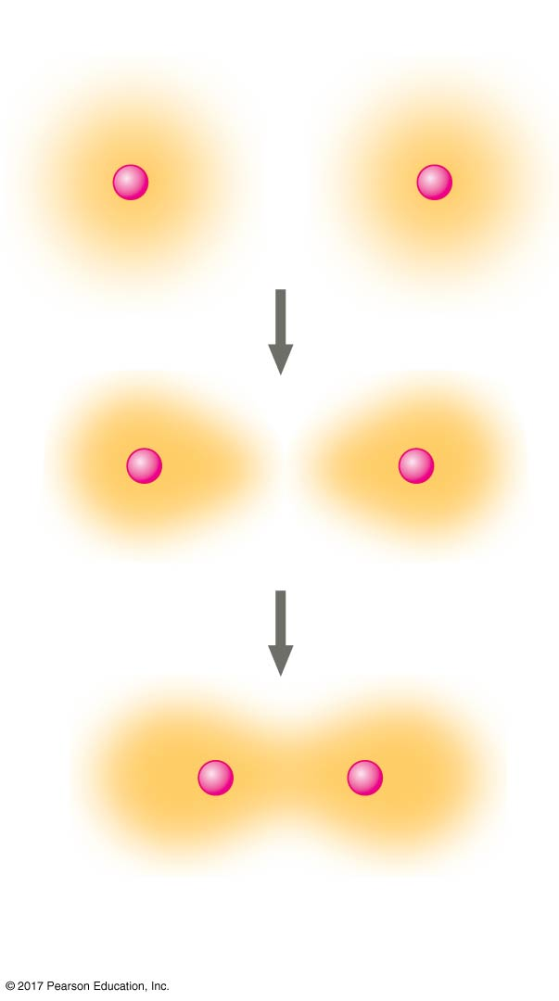
Figure 2.9_3
Hydrogen atoms (2 H)
Formation of a covalent bond
+
+
+
+
+
+
Hydrogen
molecule (H₂)
Notes:
Figure 2.9_3 Formation of a covalent bond (step 3)

Slide 31
A molecule(分子)consists of two or more atoms held together by covalent bonds
A single covalent bond, or single bond, is the sharing of one pair of valence electrons
A double covalent bond, or double bond, is the sharing of two pairs of valence electrons

Slide 32
The notation used to represent atoms and bonding is called a structural formula
For example, H—H
This can be abbreviated further with a molecular formula
For example, H₂

Slide 33
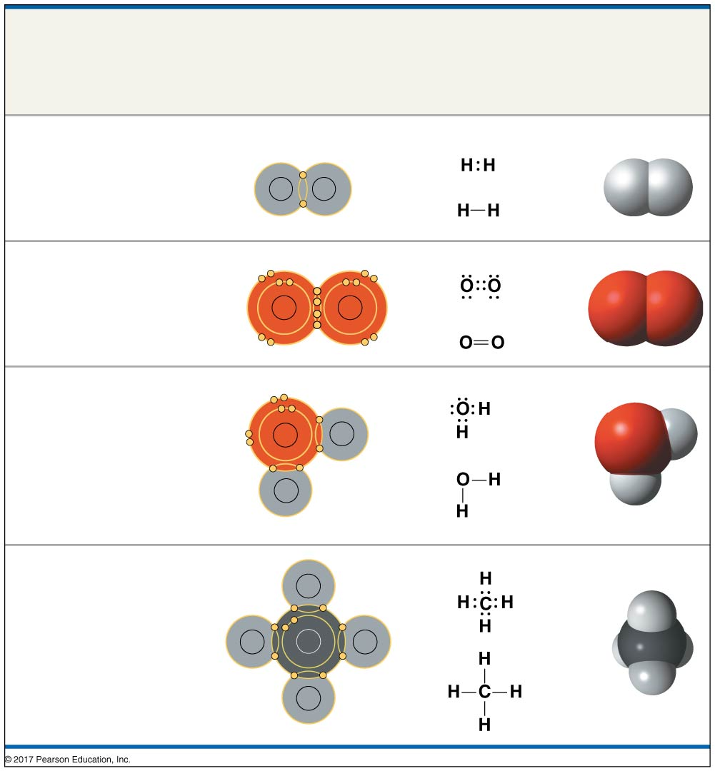
Figure 2.10
Name and
Molecular
Formula
Electron
Distribution
Diagram
Lewis Dot
Structure and
Structural
Formula
Space-
Filling
Model
(a) Hydrogen (H₂)
H
H
(b) Oxygen (O₂)
O
O
(c) Water (H₂O)
O
H
H
(d) Methane (CH₄)
H
H
C
H
H
Notes:
Figure 2.10 Covalent bonding in four molecules

Slide 34
Bonding capacity is called the atom’s valence
Covalent bonds can form between atoms of the same element or atoms of different elements
A compound is a combination of two or more different elements

Slide 35
Atoms in a molecule attract electrons to varying degrees
Electronegativity is an atom’s attraction for the electrons in a covalent bond
The more electronegative an atom is, the more strongly it pulls shared electrons toward itself

Slide 36
In a nonpolar covalent bond, the atoms share the electron equally
In a polar covalent bond, one atom is more electronegative, and the atoms do not share the electron equally
Unequal sharing of electrons causes a partial positive or negative charge for each atom or molecule

Slide 37
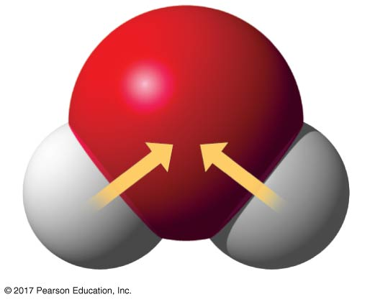
Figure 2.11
Polar covalent bonds in a water molecule
δ−
δ−
O
H
H
δ+
δ+
H₂O
Notes:
Figure 2.11 Polar covalent bonds in a water molecule

Slide 38
Ionic (離子的)Bonds
Atoms sometimes strip electrons from their bonding partners
An example is the transfer of an electron from sodium to chlorine
After the transfer of an electron, both atoms have charges
A charged atom (or molecule) is called an ion

Slide 39
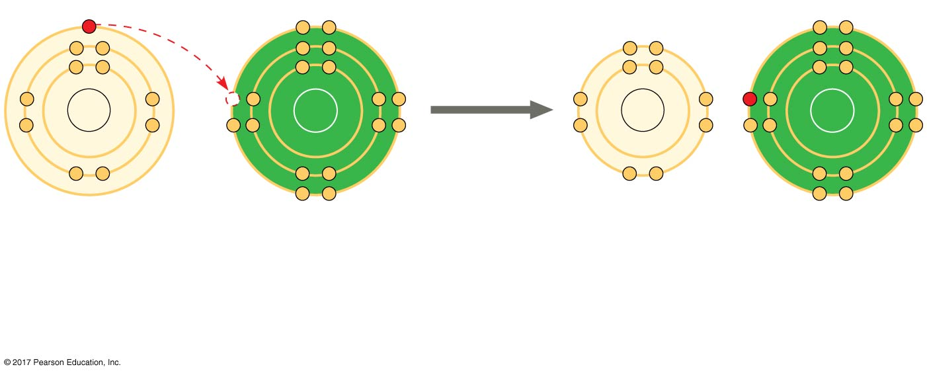
Figure 2.12_2
Electron transfer and ionic bonding
+
−
Na
Cl
Na
Cl
Na
Cl
Na⁺
Sodium ion
(a cation)
Cl⁻
Chloride ion
(an anion)
Sodium atom
Chlorine atom
Sodium chloride (NaCl)
Notes:
Figure 2.12_2 Electron transfer and ionic bonding (step 2)

Slide 40
A cation陽離子is a positively charged ion
An anion陰離子is a negatively charged ion
An ionic bond is an attraction between an anion and a cation

Slide 41
Compounds formed by ionic bonds are called ionic compounds, or salts
Salts, such as sodium chloride (table salt), are often found in nature as crystals

Slide 42
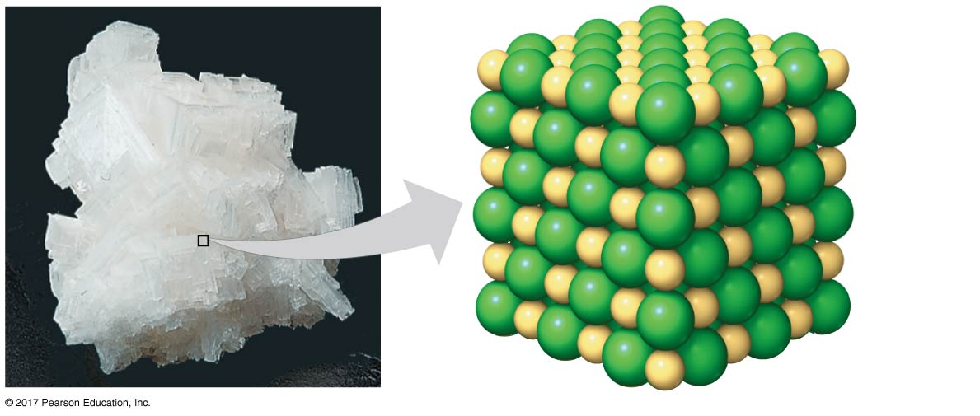
Figure 2.13
A sodium chloride (NaCl) crystal
Na⁺
Cl⁻
Notes:
Figure 2.13 A sodium chloride (NaCl) crystal

Slide 43
Weak Chemical Interactions
Most of the strongest bonds in organisms are covalent bonds that form a cell’s molecules
Many large biological molecules are held in their functional form by weak bonds
The reversibility of weak bonds can be an advantage

Slide 44
Hydrogen Bonds
A hydrogen bond forms when a hydrogen atom covalently bonded to one electronegative atom is also attracted to another electronegative atom
In living cells, the electronegative partners are usually oxygen or nitrogen atoms

Slide 45
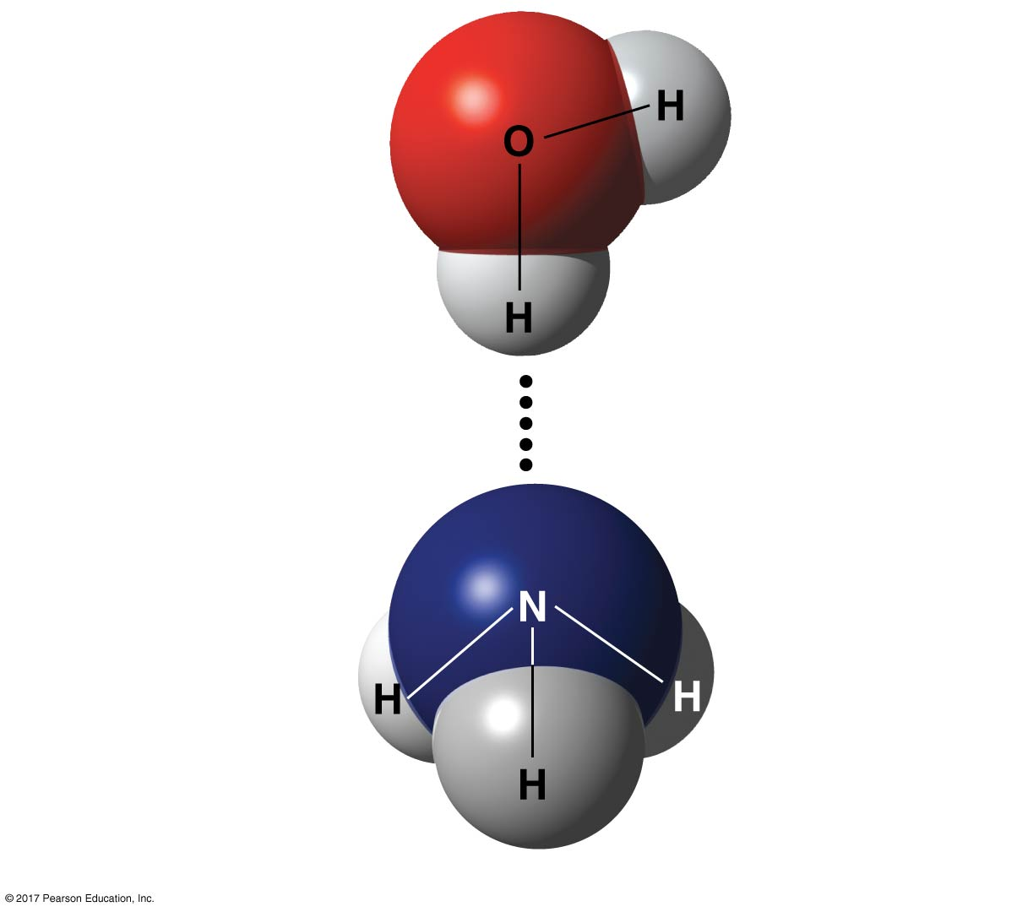
Figure 2.14
δ–
δ+
Water (H₂O)
δ–
δ+
Hydrogen bond
δ–
Ammonia (NH₃)
δ+
δ+
δ+
Notes:
Figure 2.14 A hydrogen bond

Slide 46
Van der Waals Interactions
If electrons are not evenly distributed, they may accumulate by chance in one part of a molecule
Van der Waals interactions are attractions between molecules that are close together as a result of these charges

Slide 47
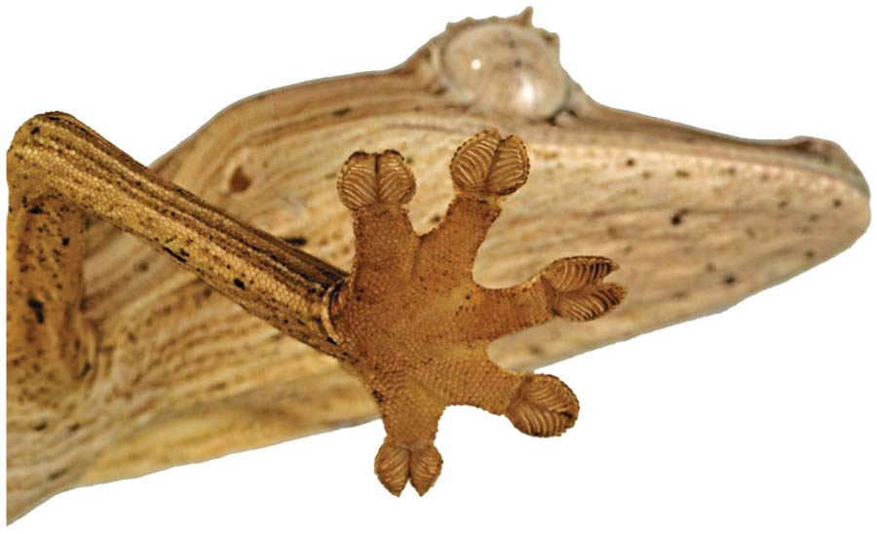
Collectively, such interactions can be strong, as between molecules of a gecko’s toe hairs and a wall surface

Slide 48
Molecular Shape and Function
A molecule’s size and shape are key to its function
A molecule’s shape is determined by the positions of its atoms’ orbitals
In a covalent bond, the s and p orbitals may hybridize, creating specific molecular shapes

Slide 49
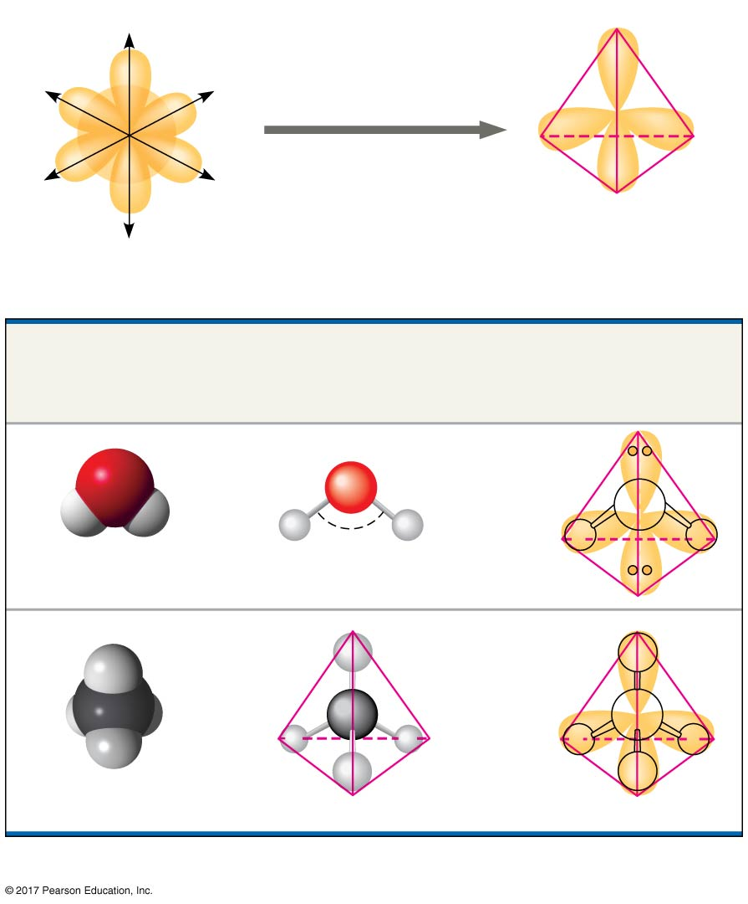
Figure 2.15
s orbital
z
Four hybrid orbitals
Three p orbitals
x
y
Tetrahedron
(a) Hybridization of orbitals
Space-Filling
Model
Ball-and-Stick
Model
Hybrid-Orbital Model
(with ball-and-stick
model superimposed)
O
Unbonded
electron
pairs
O
H
104.5º
H
H
H
Water (H₂O)
H
H
C
C
H
H
H
H
H
H
Methane (CH₄)
(b) Molecular-shape models
Notes:
Figure 2.15 Molecular shapes due to hybrid orbitals

Slide 50
Molecular shape determines how biological molecules recognize and respond to one another
Opiates鴉片類藥物, such as morphine, and naturally produced endorphins have similar effects because their shapes are similar and they bind the same receptors in the brain

Slide 51
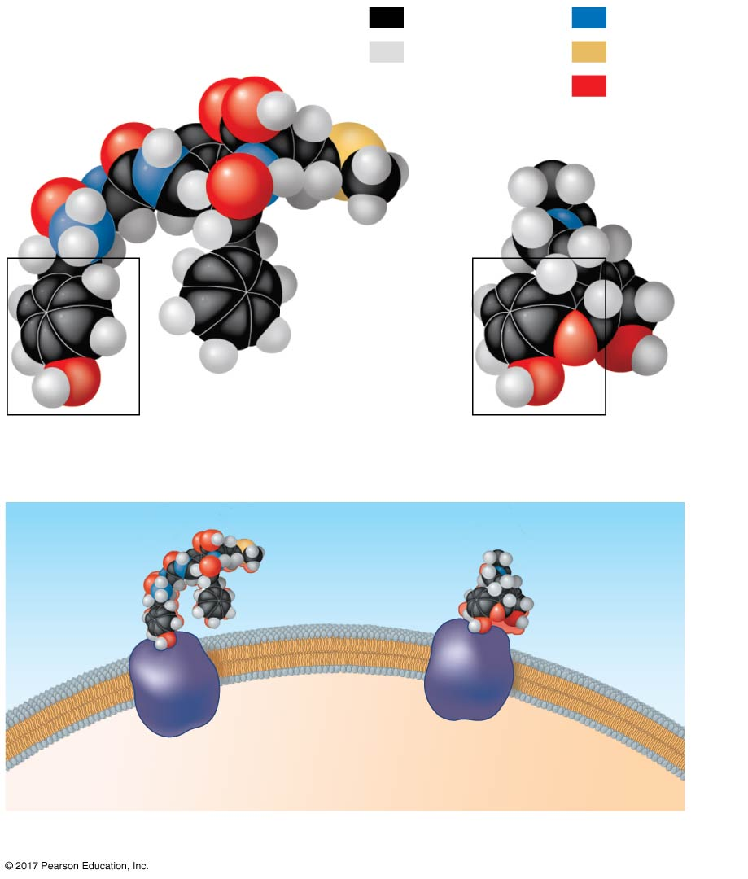
Figure 2.16
Carbon
Nitrogen
Natural
endorphin
Hydrogen
Sulfur
Oxygen
Morphine
(a) Structures of endorphin and morphine
Natural
endorphin
Morphine
Endorphin
receptors
Brain cell
(b) Binding to endorphin receptors
Notes:
Figure 2.16 A molecular mimic

Slide 52
Concept 2.4: Chemical reactions make and break chemical bonds
Chemical reactions are the making and breaking of chemical bonds
The starting molecules of a chemical reaction are called reactants反應物
The final molecules of a chemical reaction are called products產物

Slide 53
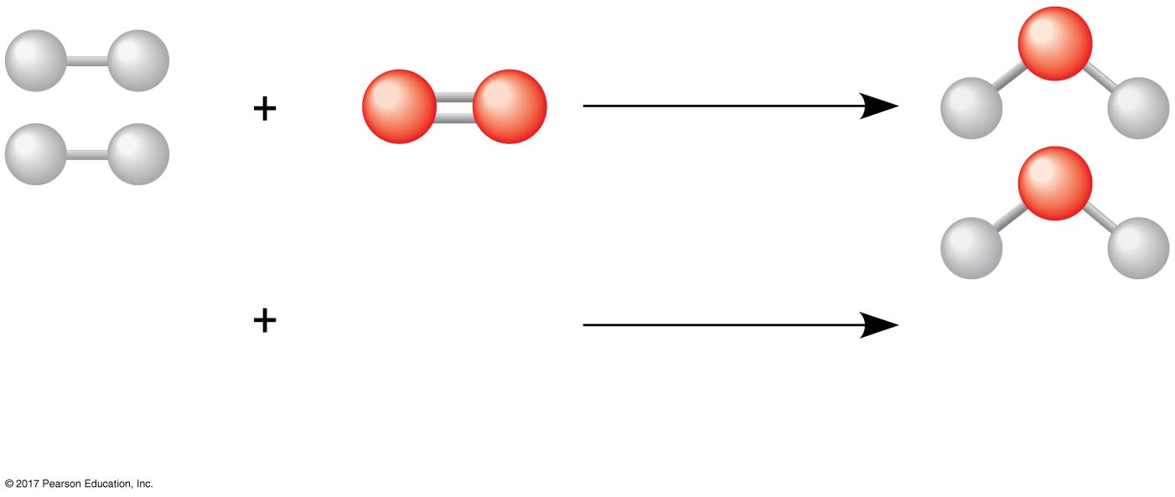
Figure 2.UN03
Water formation
2 H₂
O₂
2 H₂O
Reactants
Chemical
reaction
Products
Notes:
Figure 2.UN03 In-text figure, water formation, p. 88

Slide 54
Photosynthesis is an important chemical reaction
Sunlight powers the conversion of carbon dioxide and water to glucose and oxygen
6 CO₂ + 6 H₂O → C₆H₁₂O₆ + 6 O₂

Slide 55
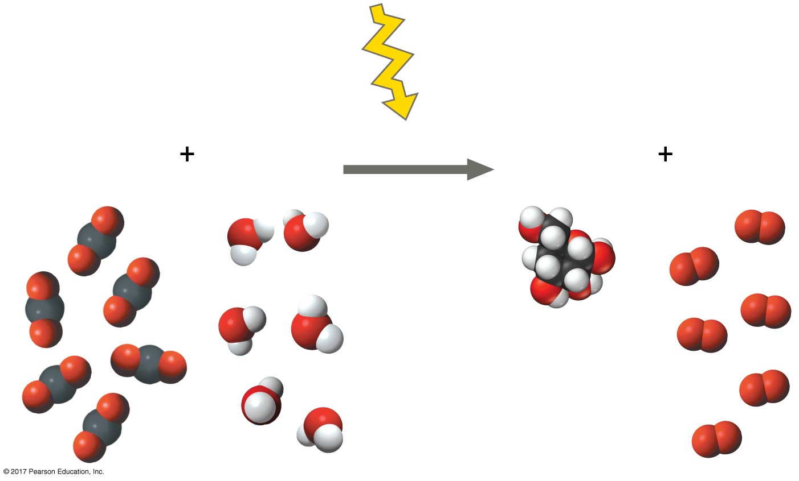
Figure 2.UN04
Photosynthesis
Reactants
Products
6 CO₂
Carbon dioxide
6 H₂O
Water
Sunlight
C₆H₁₂O₆
Glucose
6 O₂
Oxygen
Notes:
Figure 2.UN04 In-text figure, photosynthesis, p. 89

Slide 56
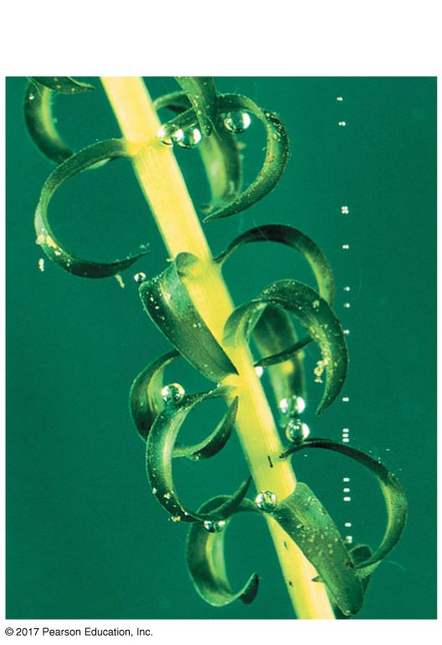
Figure 2.17
Photosynthesis: a solar-powered rearrangement of matter
Leaf
Bubbles of O₂
Notes:
Figure 2.17 Photosynthesis: a solar-powered rearrangement of matter

Slide 57
All chemical reactions are reversible: Products of the forward reaction become reactants for the reverse reaction
The two opposite-headed arrows indicate that a reaction is reversible
3 H₂ + N ⇌ 2 NH₃

Slide 58
Chemical equilibrium is reached when the forward and reverse reactions occur at the same rate
At equilibrium the relative concentrations of reactants and products do not change

